Slide 1
Exploring Blockchain Applications
An Interactive Walkthrough
Jack Bonaguro
Vice President, Blockchain & Cryptocurrency @ Georgia Tech

Slide 2
Requirements
Interest in blockchain technology
Windows/OSX/Linux/etc
Chrome/Firefox/Opera + Internet Connection
https://github.com/jackbonaguro/blockchainpresentation.git
Notes:
Lay out talk goals, who the talk is for, and who it’s not for
Github link also on facebook event page - make sure everyone likes the facebook event so they can get the address later

Slide 3
About Speed
Lots of ground to cover in short time
I will try to ask if we’re ready to move on
Try to keep conceptual questions for the end
Ask if you’ve missed a step and I can go back

Slide 4
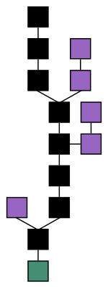
Introduction to Blockchain
Computing power based - no one can be more powerful than everyone else
Majority consensus - everyone acting in self-interest means everyone must agree
Transactions and state - perfect for keeping track of money
Notes:
In a nutshell, a bunch of people agree to keep confirming ‘blocks’ in a continuing ‘chain’.

Slide 5
An Example - Ethereum + Tools
The Rinkeby Testnet - MyEtherWallet - create testnet wallet, password, keystore MetaMask - import keystore Send transaction with test ethereum View Confirmation on rinkeby.etherscan.io
Ethereum is one of the most widely used blockchains
Enables Smart Contracts
Etherscan.io
Addresses, Transactions, Blocks
MyEtherWallet.com
Wallet Creation, Sending TXs
Notes:
There are a few fundamental things you need to understand to use a blockchain. The first is a wallet, which is just a long sequence of numbers that money can be sent to and from.
Transactions can also be viewed in the explorer, listing to and from addresses and the amount
A group of transactions is confirmed as a block. When a block is confirmed all those transactions are agreed upon by the network

Slide 6
MetaMask
MetaMask.io
Wallet as browser extension
Turns browser into ethereum browser by injecting Web3.js
Works by publishing to cloud ethereum nodes, otherwise you’d need to download the whole chain
Notes:
There are many software wallets for Ethereum, and metamask is one of them. It is unique in that it is packaged as a chrome extension. This allows it to not only send your money but interact with web pages, turning your browser into an ethereum browser. It works by publishing transactions on request to infura.io, a group of ethereum nodes running in the cloud.

Slide 7
Sending with MetaMask
The Rinkeby Testnet - https://www.rinkeby.io/#faucet
MyEtherWallet - create testnet wallet, password, keystore
MetaMask - import keystore
Send transaction with test ethereum
View Confirmation on rinkeby.etherscan.io
Notes:
Rinkeby testnet is a clone of the ethereum network that runs the same software, but has only a few nodes. This makes it very cheap to run, and so test ethereum can be distributed for free.
Have them copy you in creating a testnet MEW wallet - they will need it later.

Slide 8
Ethereum as a Smart Contract Platform
Smart Contract
Code executing instructions transparently
On the blockchain so results are immutable
Compare to use of force for traditional contract enforcement
Ex. timers, voting, financial agreements, etc.
Ethereum Virtual Machine (EVM) is a Turing-Complete Architecture
Can execute arbitrary programs governing money + data on the chain
Notes:
Turing complete is a computer science term that basically means it can run any program any other computer can run. So, while it would be painfully slow, someone could in theory port pokemon to run on ethereum. But please don’t ever do that.

Slide 9
Solidity Programming Language + Tools
Solidity compiles to EVM bytecode
Compile open-source contracts to verify they work as intended
Remix.Ethereum.org - Full-featured IDE for smart contracts
Notes:
Solidity is a high-level programming language for ethereum. It can be compiled into bytecode, which executes on the EVM every time you call a function.

Slide 10
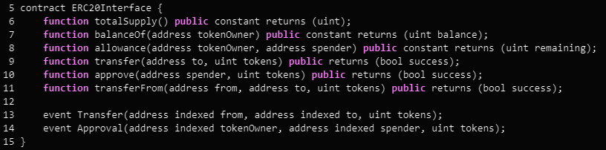
The ERC20 Token Standard
Standard interface for transfers & checking balances (ex. MetaMask)
Coinmarketcap.com/tokens/ - Mostly ERC20 compliant
Notes:
Events are a unique form of storage in solidity. They enable applications to see a searchable history. So hypothetically, with the transfer and approval events, we could make an explorer app for just this token.

Slide 11

Our Contract - BuzzToken
Registration phase - anyone who sends a registration TX will receive exactly 10 BUZZ
Only owner can end registration
After registration it behaves as a normal ERC20 token

Slide 12
The Code
https://github.com/jackbonaguro/blockchainpresentation/blob/master/Contracts/BuzzToken.sol
Solidity Syntax / Data Structures
Certain functions restricted to owner, others are public
No functions marked payable, so contract can’t take payment

Slide 13
Compiling and Publishing
Remix can automatically compile and check for warnings / errors
Publish - from a wallet address, creates a contract address
Uses MetaMask to publish our contract creation to the testnet - rinkeby.etherscan.io

Slide 14
Registering for our Tokens
Remix
Open up the contract in remix
Compile and instantiate at the address
Call the ‘register’ function
MyEtherWallet
Copy the code into MEW
Get ABI from Remix, copy into MEW
Call the ‘register’ function

Slide 15
After Registration
I will call the ‘endRegistration’ function the same way. As the ‘owner’, I’m the only one who can call it.
Now it behaves as an ERC20 token, so I will transfer some to my new wallet
Notes:
Once registration has ended, the transfer functions all work like you’d expect. I will demonstrate this by transferring some to my new wallet.

Slide 16
Decentralized Applications
github.com/jackbonaguro/blockchainpresentation/TestDapp.html
Uses the web3.js provided by MetaMask
Can automate reading / writing to the blockchain
Popular examples: Etherdelta.com, Cryptokitties.co

Slide 17
Wrap-Up
Blockchain is not that complicated, just foreign
Smart Contracts can be really useful
It is almost too easy to create Tokens on Ethereum
If you registered, you now have 10 BUZZ until you transfer or lose your key

